Slide 1
Programing and Problem Solving
Lecture2
Israa S. Ameer

Slide 2
Introduction To Programming Fundamentals
programming language is a set of commands, instructions, and other syntax use to create a software program . There are many languages that allow humans to communicate with computers; C++, BASIC, and Java are some common ones.
Machine language
Assembly language
High-level languages

Slide 3
Machine language
Only language computer directly understands
Defined by hardware design
Machine-dependent
Generally consist of strings of numbers
Ultimately 0s and 1s
Instruct computers to perform elementary operations
One at a time
Cumbersome for humans
Example:
00000000 Stop Program
00000001 Turn bulb on
00000010 Turn bulb off
01000000 Go to start of program (address 0)

Slide 4
Assembly language
English-like abbreviations representing elementary computer operations
Clearer to humans
Incomprehensible to computers
Translator programs (assemblers)
Convert to machine language
Example:
LOAD data1
ADD data2
STORE total

Slide 5
High-level languages
e.g. C, C++, Python, FORTRAN, Java, Pascal, Visual Basic, JavaScript
Use common mathematical notations
Single statements accomplish substantial tasks
Assembly language requires many instructions to accomplish simple tasks
Translator programs (compilers)
Convert to machine language
Example:
If (number > 0) { cout << "You entered a positive integer: " << number << endl; }

Slide 6
C++ Language
C++ is known to be a very powerful language. C++ allows you to have a lot of control as to how you use computer resources and memory.
C++ is one of the world's most popular programming languages.
C++ can be found in today's operating systems, Graphical User Interfaces, and embedded systems.
As C++ is close to C# and Java, it makes it easy for programmers to switch to C++ or vice versa
C++ was developed by Bjarne Stroustrup starting in 1979 at Bell Labs in Murray Hill, New Jersey, as an enhancement to the C language and originally named C with Classes but later it was renamed C++ in 1983.

Slide 7
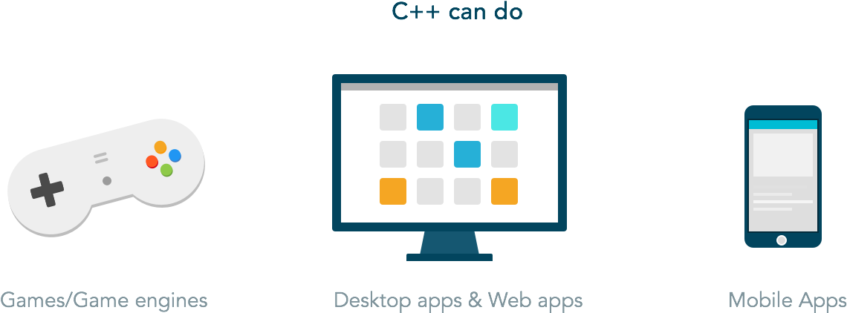

Slide 8
C++ Compiler
Because a computer can only understand machine language and humans wish to write in high level languages high level languages have to be re-written (translated) into machine language at some point. This is done by special programs called compilers, interpreters, or assemblers that are built into the various programming applications.
C++ compiler is an actual compiler, which will be used to compile your source code into final executable program.
Most C++ compilers don't care what extension you give to your source code, but if you don't specify otherwise, many will use .cpp by default.

Slide 9
Structure of a program

Slide 10
#include <iostream> is a header file library that lets us work
with input and output objects, Header files add functionality to
C++ programs.
using namespace std means that we can use names for objects and variables from the standard library.
int main(). This is called a function. Any code inside its curly brackets {} will be executed.
return 0 ends the main function.
cout (pronounced "see-out") is an object used together with the
insertion operator (<<) to output/print text.
cin object is used along with the extraction operator (>>) in order to
receive a stream of characters.

Slide 11
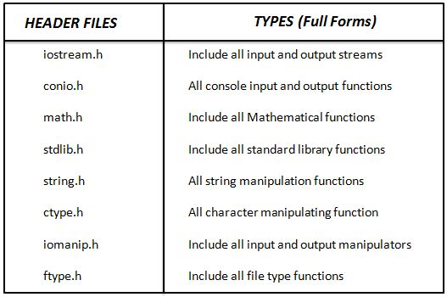
Header files

Slide 12
variables
A variable provides us with named storage that our programs can manipulate. Each variable in C++ has a specific type, which determines the size and layout of the variable's memory; the range of values that can be stored within that memory; and the set of operations that can be applied to the variable.
For example a variable X is equal to 3, another variable called B is equal to 4. If we want to add these variables we should define another variable to obtain the result, let it be Z.
X=3;
Y=4;
Z=X+Y;
Each statement should ended with semicolon
Variables

Slide 13
Data types
Character types: They can represent a single character, such as 'A' or '$'. The most basic type is char, which is a one-byte character. Other types are also provided for wider characters.
Numerical integer types: They can store a whole number value, such as 7 or 1024. They exist in a variety of sizes, and can either be signed or unsigned, depending on whether they support negative values or not.
Floating-point types: They can represent real values, such as 3.14 or 0.01, with different levels of precision, depending on which of the three floating-point types is used.

Slide 14
Boolean type: The Boolean type, known in C++ as bool, can only represent one of two states, true or false. For example a variable (a) equal to 99 so it defined as int, a variable (b) equal to 0.674 so its data type is float, another variable (c) equal to 'ahmed' then its data type is char.
int a=99;
float b=0.674;
char c='ahmed’;
bool x=true;
bool y=false;

Slide 15
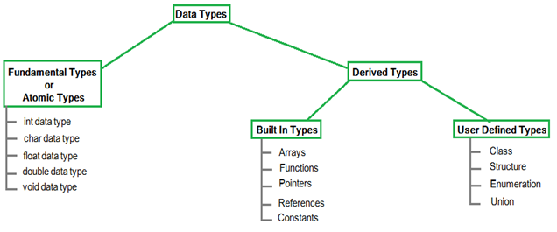

Slide 17
Program1
Write a C++ program to display "Its my first program!" on the screen
#include <iostream>
using namespace std;
int main()
{
cout << "Its my first program!";
return 0;
}

Slide 18
Program2
Find the sum of two integer numbers. Then, the sum is stored in a variable and displayed on the screen.
#include <iostream>
using namespace std;
int main()
{
int a, b, sum;
cout << "Enter two integers: ";
cin >> a>> b; // sum of two numbers in stored in variable sum
sum = a + b; // Prints sum
cout << a << " + " << b<< " = " << sum;
return 0;
}

Slide 19
Program3
Write a C++ program to find the duplication of an integer value.
#include <iostream>
using namespace std;
int main ()
{
int x;
cout << "Enter an integer value: ";
cin >> x;
cout << "The value you entered is " << x;
cout << " and its double is " << x*2 << ".\n";
return 0;
}

Slide 20
Thank you

